Slide 1
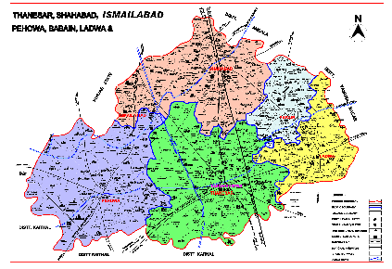
Presentation by Vinod Kumar, DIO, NIC, Kurukshetra
Kurukshetra

Slide 2
Presentation will cover ….
Initiatives
Five essential
Awareness
Apply
Status Enquiry
Monitoring
Grievances
Citizen Centric Services Dc Office/SDM Office
Citizens facilitation
Application Window
SMS Alerts about fee charged, Despatch,Objection….
Status Enquiry/Helpline
Monitoring through Alert Messages/Dash Boards
Citizen Centric Services General
Awareness Window
Events/Happening
Infrastructure
N-Computing
Dash Board
Departments Level
Revenue
Development
Education
Transport
Election
ESA
Tourism
Employment Exchange
District Library
Deaf & Dumb

Slide 3
Initiatives

Slide 4
Initiatives
Application Window

Slide 5
Initiatives
SMS

Slide 6
Initiatives
Status Enquiry / Helpline

Slide 7
Initiatives
Awareness Window

Slide 8
Initiatives
Grievances

Slide 9
Initiatives
N-Computing Devices

Slide 10
Initiatives
Dash Board (Public)

Slide 11
Initiatives
Monitoring through Alert Messages

Slide 12
Initiatives
Dash Board (Monitoring)

Slide 13
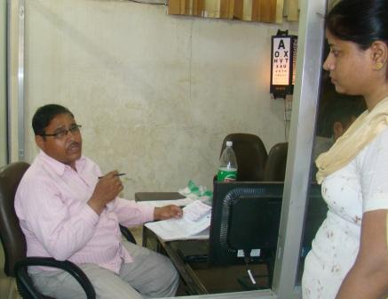
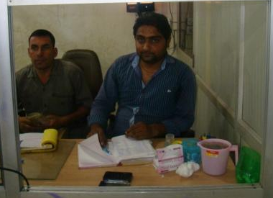
Initiatives
Queue Management
Queue Management
Doctor
Supporting Staff

Slide 15
Initiatives
Bus/Train Timing

Slide 16
Initiatives
Online Quiz

Slide 17
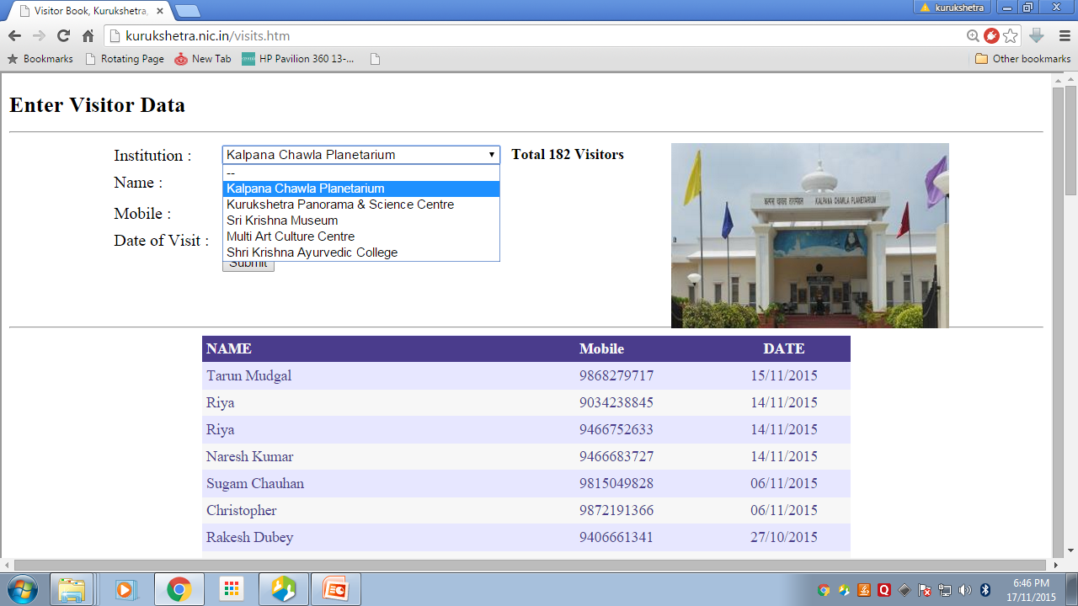
Initiatives
Digital Visitor Book

Slide 18
Village Information System

Slide 19
Initiatives
Disnic Plan

Slide 20
Employment Exchange & District Library

Slide 21
E-Patwar Seva Kendra & Modernize Record Room

Slide 22
Initiatives

Slide 23
Initiatives
Events/Happenings

Slide 24
Initiatives
Land Record
Member of Development Team
Touch Screen
E-PatwarKhana
Record Room i.e. Compactors
Election
Deployment of Staff
Communication Plan
Touch Screen
DDPO Office
MIS Room, Touch Screen, Lease Land, Surplus land …

Slide 25
Initiatives
Health
Birth & Death Scanning of Data
File Tracking System
Touch Screen
SMS
Document Required
VIMS
Dak Monitoring
Copying Branch
Budget
Bm 2629
Wifi
Result Through Binocular

Slide 26
Police Deptt.
Mobile Tracking System
Touch Screen
Act & Proc.
How we Act
Character verification

Slide 27
Deaf & Dumb

Slide 28
Online Test

Slide 29
Employees deputed on Court Cases
Honorable court may be requested to take the cases where Govt. Official are involved on a particular day of the week

Slide 30
Statistical Department should be strengthen
In Present system, in some offices even Senior Level officers are seen involved in the reporting process
Or in some cases department even not care the data
If Statistical Dept. strengthen, then integration of data can be achieved up to large extent.

Slide 31
System should be developed keeping in view the extent upto it can be implemented

Slide 32
1. Registries of Unauthorized Colonies 2. Photograph of tehsildar in Registration 3. No Tehsildar is returning the Reg. in a proper way, if it has any objection 4. NOC 5.Stay and attachments are not being maintained

Slide 33
Implementation & Monitoring
DC should only be Liaison Officer
Concerned Department should take the initiative through their department officers to implement the project i.e. Fixation of Owner ship
Cases. 1. Ration Card Data entry 2. Election data Entry 3. Birth & Death 4. CSC 5.Aadhar card

Slide 34
All Departments should be asked to update the list of Officrs/Employees on their state website. District website should provide the link only. Very bad impressions.

Slide 35
Max. document should be sent through Speed Post.
RC
DL/LL/CL
Ration Card
Sr. Citizen card
Reg. Deed

Slide 36
Payment through Credit card/DD
Online used by only few.

Slide 37
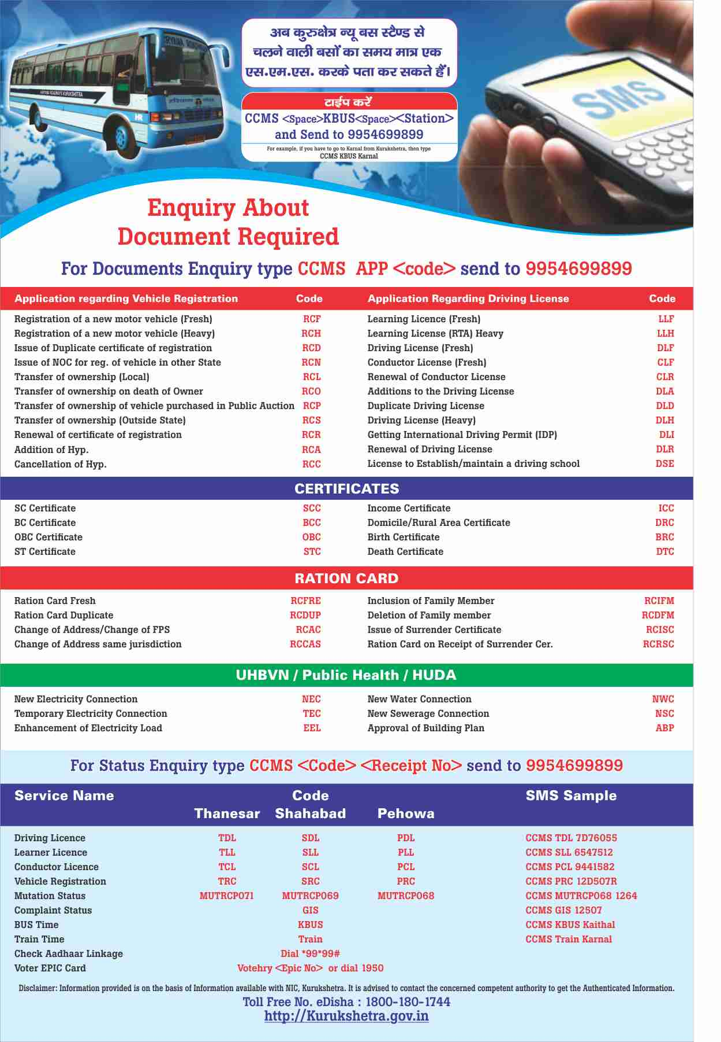

Slide 38
Thank You

