Slide 1
Deliberations on Good Governance to Strengthen and Synergize the System
District - Kurukshetra
on dated 13.11.2014
Presented by: Nikhil Gajraj, I.A.S Deputy Commissioner,
Kurukshetra

Slide 2
Grievances on part of Public
Detail | Example
Lack of Knowledge of Procedure | All
Filing the Application | All
Submission/Acceptance of Application | Multiple Windows Registration of Deed
Receipt/Over Charges
Tracking of Official/Officer | Patwari
Time Delay | Mutation …..
Lack of Information | Date and Place of Distribution of Pension Files in Recordroom Name of Contractor or person who has to execute work
Lack of Good Query System | Mobile Lost
File Tracking | Birth & Death

Slide 3
Administrative
Detail
Good Monitoring Tool/ File Tracking / Fixing of Accountability
Act/Procedure/Guidelines/Notifications
At Some Places not good Delivery Environment
Sharing of data
Shortage of Staff
Planning, wherever option is available to study the success stories, it should be e.g. Grievances through Video Conference
Frequent Transfers, some time in the middle of the execution of work

Slide 4
Delivery of Services

Slide 5
Delivery of Services
Present
Future Vision
District Level
Tehsil Level
Nearest convenient place of Citizen i.e. Village level /Ward level
Application - Blank (Red cross, Tea Stall, Touts …)
Medical - Too far
Apply - Multiple Windows (Cash Counter)
Query - Manual
Delivery - By Hand
Citizen Charter - Not Maintained
QMS - No
Info
Website - No
Touch Screen – No
SMS - No
Dashboard -No
Helpline - No
Alert - No

Slide 6
e-Maitri (CSC Centres)
Issue
Identification of Delivery of Services
Mechanism to deliver them
Application generation

Slide 7
Deliverable Services
Nakal of Jamabandi, Mutations, Registration Deed, Fard Badar, Girdawari, Roznamcha available on Touch Screen as well as on Website
Appointment of Deeds ensures acceptance of Papers and refusal with genuine reasons in writing
Search By Owner name, Cultivator, Khewat , Khasra No., Registration Deed No. etc. provides ease of access to information with minimum parameters.
Status Entry – Mutations (Whether Entered or Not Verified, Sanctioned, Incorporated)
Online status of Jambandi shows the present position of the owners/cultivators.
For issuing of Certificates (SC/BC/OBC/Income etc.) citizens can apply onsite and application can be processed at tehsil level without the necessity of public to visit personally and final certificate can be received through E-mail, at the concerned E –Maitri centre or through registered post.

Slide 8
Deliverable Services
Birth and Death: Explain ACT and Procedure. Apply Online. Check Status and can facilitate in verification the document already issued and submitted to any agency.
Mobile Lost: Search Facility whether found or not Found. How many times put on surveillance?
Aadhar Card: Status Enquiry, Demographic changes (Change of Address),linkage with Banks for disbursement of subsidies.
Pension: Enquiry, Distribution Information, Procedure and can facilitate in applying.
Complaints: Online Entry, Status Enquiry
Electricity: Bill Generation,
Online Gas Booking,/Electricity/Telephone/LIC Premium/HUDA Bills
Court Cases Status Enquiry
Election Department – Voter Enquiry/Apply
Results Enquiry

Slide 9
e-Maitri (CSC Centres)
Touch Screen (main view)
Search Window

Slide 10
e-Maitri (CSC Centres)
Touch Screen

Slide 11
Application Window

Slide 12
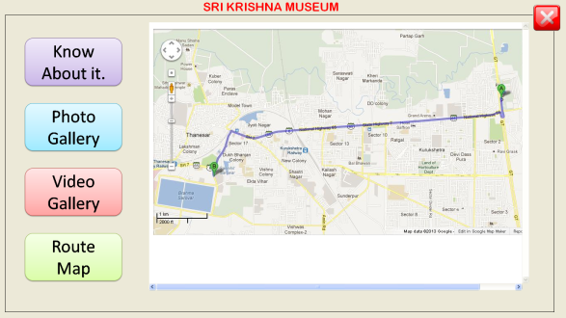
e-Maitri (CSC Centres)

Slide 13
e-Maitri (CSC Centres)
Regd. Agriculture on Touch Screen
Videos
Addresses
Rates
SMS
Photo Gallery
Training Prog.

Slide 14
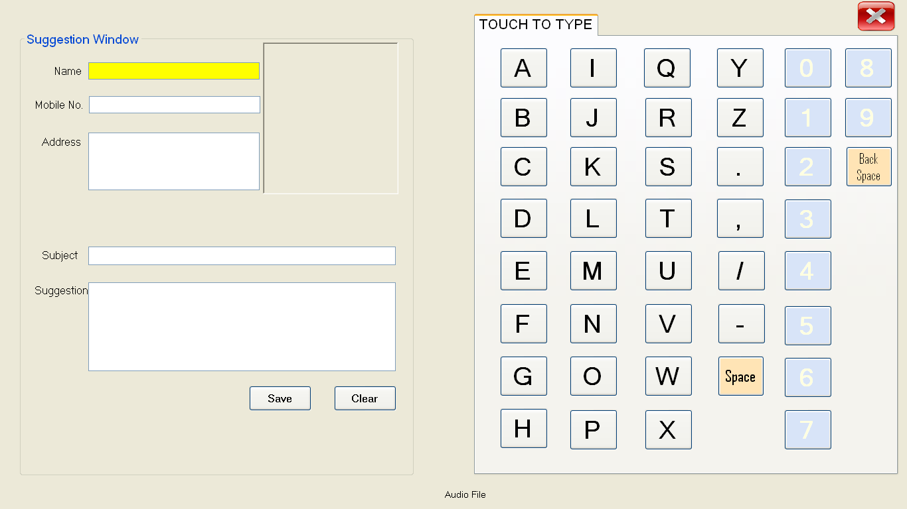
e-Maitri (CSC Centres)
Lodge Complaint (Touch Screen)

Slide 15
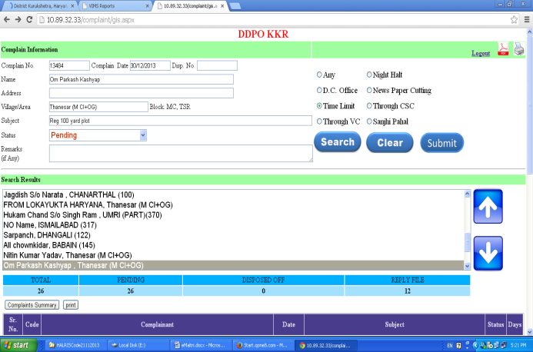

Slide 16
User Name/Password
User Name & Password has been issued to Every department/office. Please Got it from NIC if not available

Slide 17
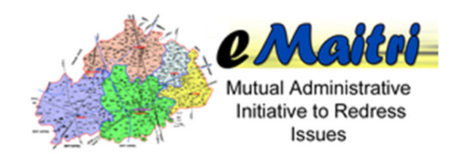
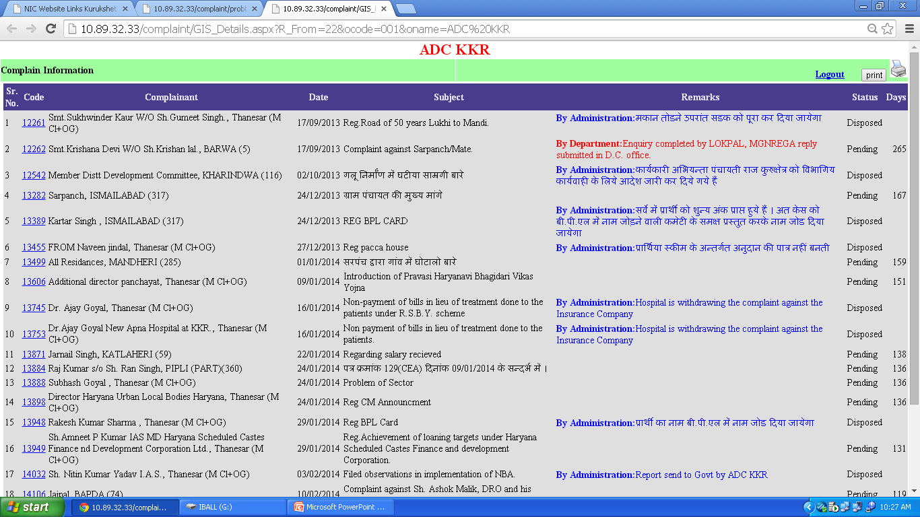

Slide 18
Online Access of Complaints
All the Complaints in Time Limit are Scanned and available online to individual department after login Online Portal.

Slide 19
Helpline
1800 180 1744

Slide 20
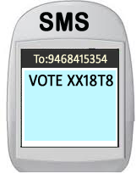
Enquiry By SMS
Complainant can also check the status of their complaints by Sending SMS
CCMS GIS <Complaint ID> 9954699899
the Complaint Status will be send on Mobile.
To :- 9954699899
CCMS GIS <Complaint ID>

Slide 21
Enquiry By SMS (Online)
Complainant can also check the status by entering the Complaint ID and Mobile No. on Website.
the Complaint Status will be send on Mobile.

Slide 22
Enquiry on Touch Screen

Slide 23
Status on SMS (Monitoring)
Total Pending Complaint to : -
Nodal officer.
DIO/Operator/CTM
Every Week.

Slide 24
Receipt Issued to All
A new Unique Complaint ID is generated and Computerized receipt is issued to all after lodging a new complaint.

Slide 25
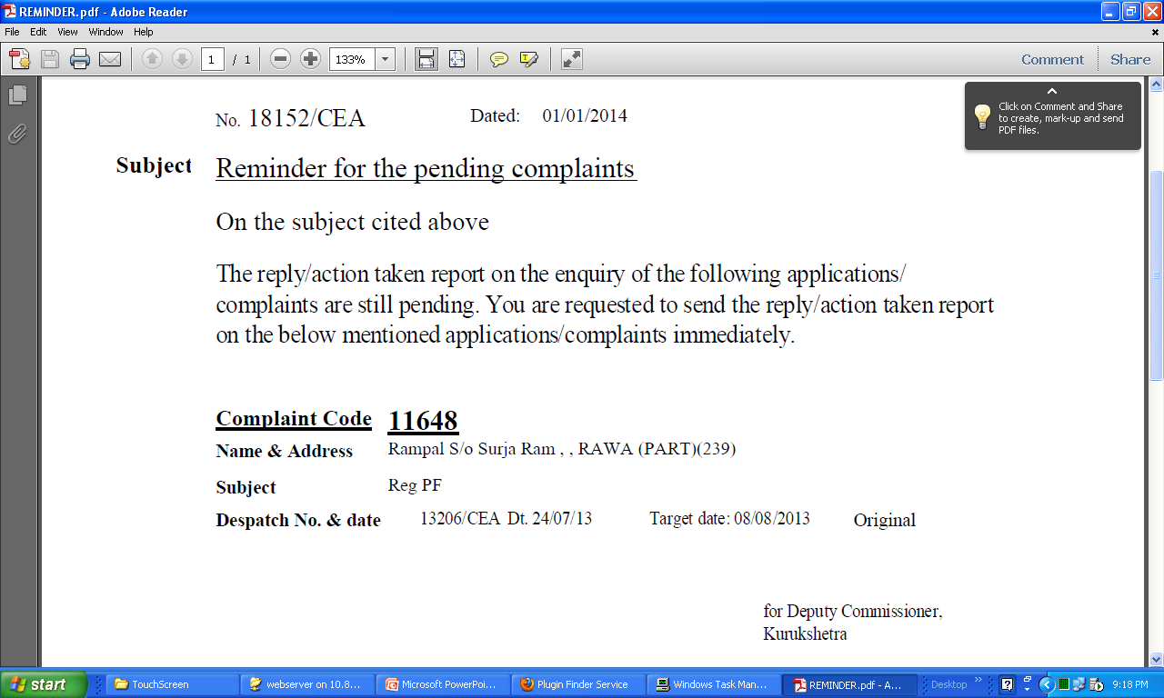
Reminder Issued to All
Reminders are issued to all departments for the pending complaints.

Slide 26
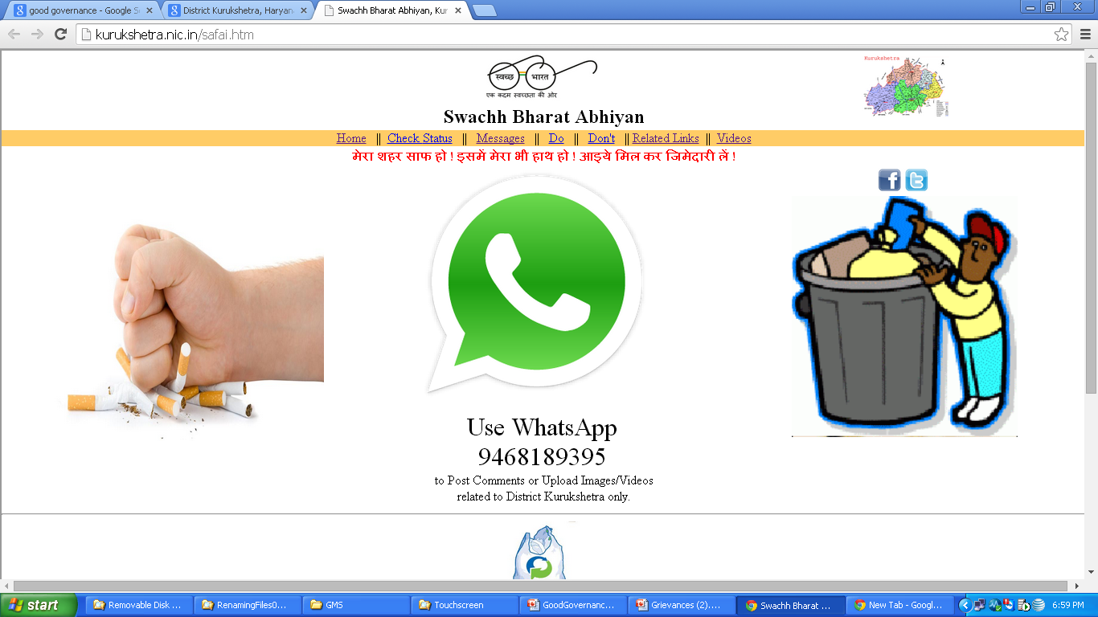

Slide 27
Use of Whatsapp Application for implementation of SWACHH BHARAT ABHIYAN
Whatsapp application used for the implementation of the project for the first time.
Different nodal officers were appointed Ward wise in Urban areas and at cluster level at villages.
Real time review of cleanliness drive made possible and each nodal officer was required to update before and after pictures of the areas sanitized on the central whatsapp number.
Different folders of different Nodal officers were created to ensure proper accounting of the number of activities undertaken by each officer
Total of ~3200 pictures collected depicting the activities undertaken in the district during the swachta saptah.

Slide 29
Land Record
Done
All Villages (419) Online Integrated with Land Record
Data Updation on website : 15 minutes
Scanning: Resgistration of Deeds (100 %), Mutation (Immediately at the time of Incorporation), All Mausawi. Field Books (Locally) available on Touch Screen
Appointment Management System : First Pilot District
Renovation of Halris/Edisha Centre : Five out of Six. Ladwa shortly.
All Girdawari Books generated through Jamabandi data (Computerised)
Facilities like Touch Screen, Query through SMS, Website available, Alert Message to SDMs/Tehsildar/Patwari at regular Interval.
e-Patwarkhana : One at Pehowa
Query Management System : Inform the applicant after generation of Nakal to receive
Dashboard Available for both Public as well as Officer to get the latest status.
Mutation immediately

Slide 30
Land Record
Needs to be Done
Issue of Nakal of Girdawari, Mutation, Registration Deed
Digitisation of Mausawi: Pending on part of Harsac.
Renovation of Halris/Edisha Centre
e-Patwarkhana

Slide 31
Touch Screen
Total Four Types
DC Office
CSC
Police
Development

Slide 32
DC Office

Slide 33
DDPO/BDPO Office i.e. MIS ROOM

Slide 34
Police Department i.e. SP Office

Slide 35
E-Maitri

Slide 36
Thanks

